Slide 1
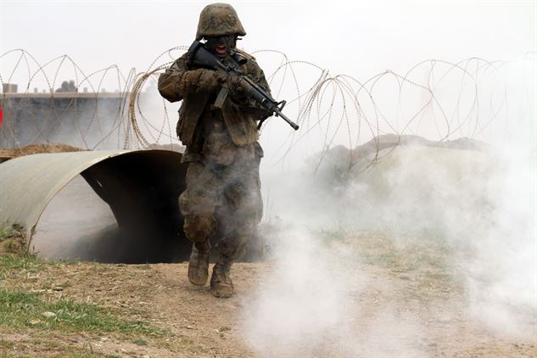
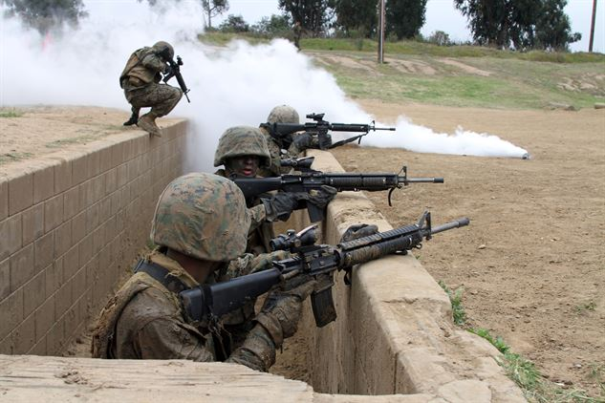
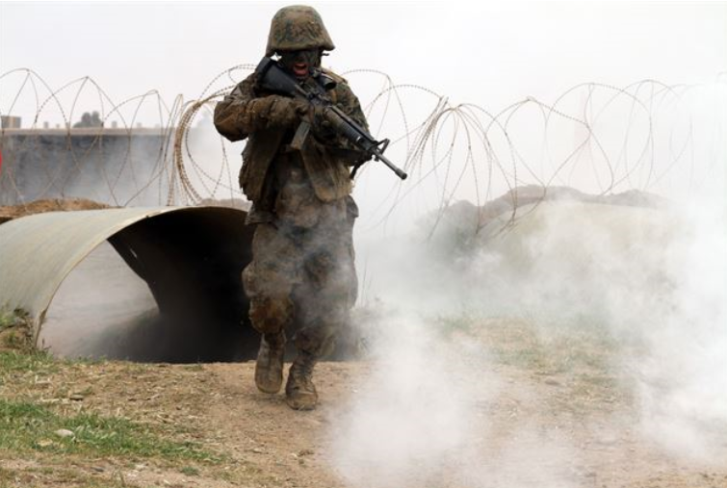
Copeland's Assault Course instills combat mindset
Camp Pendleton -- Communication in a combat environment is crucial to mission accomplishment and could be a determining factor in the life of a Marine, especially when the environment is chaotic.
During the Crucible, a 54-hour field training exercise, recruits are required to use communication skills that were instilled in them throughout training to work together and complete any mission at hand.
Recruits put their skills to use during Copeland’s Assault Course, a simulated combat environment with obstacles such as tunnels, walls, barbed wire and trenches.
“The purpose of (Copeland’s Assault Course) is to maneuver through the course with your fire team, while practicing communication skills.” “It also teaches them how to stay focused through the fog of war.”
The fog of war is a term used by service members to describe the uncertainty in situational awareness experienced by an individual in a war zone. From bombs bursting to bullets flying over head, one could easily lose focus.
Sounds of simulated gun fire and explosions replaced what was once silence. The recruits ran the course in teams of four and began to maneuver their way through the obstacles, while using verbal and hand commands to communicate with each member of their team.
A recruit of Company C, 1st Recruit Training Battalion, rushes from one obstacle to the next during Copeland's Assault Course at Edson Range aboard Marine Corps Base Camp Pendleton, CA. Recruits are put through a simulated, stressful combat environment so they can better their communication skills.
Fellow recruits wait inside a trench for the fourth member of their fire team during Copeland's Assault Course, an event part of the Crucible, at Edson Range at Camp Pendleton. This event teaches recruits the importance of teamwork and communication through a simulated combat environment.

